Slide 1
Empowering Patient Voices: Integrating Patient Reported Data in Clinical Records
Course :CIV ENG 190 S
Mentor : Professor Gora Datta
Project By:
Adithya Ayanam

Slide 2

Project Overview
To analyze hospital capacity and patient satisfaction, using data from two key sources:
Hospital bed information
HCAHPS(Hospital consumer Assessment of Healthcare Providers and Systems) survey.

Slide 3

Problem Statement
Context:
Hospitals strive to deliver high-quality patient care, yet patient satisfaction varies widely.
Key factors affecting patient satisfaction, such as:
Hospital size (bed capacity)
Specific patient care practices
Variability in satisfaction across service areas
Key Questions:
Does hospital size correlate with patient satisfaction?
Which patient care aspects score highest and lowest in satisfaction?
What actionable improvements can hospitals implement to enhance patient experience?
Objective:
Analyze hospital characteristics and patient satisfaction data (HCAHPS) to uncover insights and recommend improvements for better patient outcomes and experience.

Slide 4
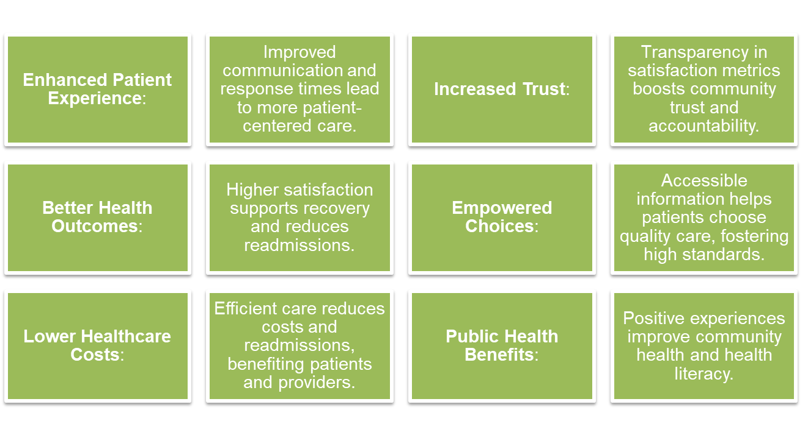
Community Impact

Slide 5

Data Overview
1. Data Sources
Hospital Beds Dataset: Contains information on hospital capacity, such as number of beds.
HCAHPS Survey Dataset: National survey data on patient satisfaction across various care dimensions.
2. Key Variables
Number of Beds: Reflects hospital size, used to categorize hospitals.
HCAHPS Answer Percent: Satisfaction scores based on patient feedback.
3. Purpose of Each Dataset
Hospital Beds: Helps understand operational scale and potential impact on patient experience.
HCAHPS Survey: Captures patient perceptions, essential for identifying high- and low-performing care areas.
4. Integration of Datasets
Merging datasets by Facility ID provides a unified view, linking hospital size with patient satisfaction scores.

Slide 6
Understanding HCAHPS Measures
Key HCAHPS Measures:
What is HCAHPS?
National survey assessing patients’ hospital experiences
Standardized to compare hospitals and guide improvements
Importance of HCAHPS:
Tied to Medicare funding and hospital incentives
Helps hospitals identify strengths and improvement areas to enhance patient care
Rating System:
Frequency Scale: Always, Usually, Sometimes, Never
Star Ratings: 1 to 5 stars for some measures
Care Transition: Support during transitions (e.g., home care)
Nurse Communication: Clear instructions, attentiveness
Environment: Cleanliness and noise levels
Doctor Communication: Listening, clear explanations
Discharge Information: Clear post-discharge instructions
Staff Responsiveness: Timely response to patient needs
Medication Communication: Explanation of purpose and side effects
Pain Management: Effectiveness in managing pain

Slide 7
Analysis Approach
1. Descriptive Statistics
Calculate averages, medians, and distributions for key variables (e.g., bed capacity, satisfaction scores).
2. Visualization Techniques
Histograms: Show distributions of bed capacity and satisfaction ratings.
Box Plots: Compare satisfaction across hospital size categories.
Scatter Plot: Explore relationship between bed count and satisfaction.
3. Trend Analysis
Identify high and low-performing HCAHPS measures.
Examine patterns by hospital size, region, and care dimension.
4. Key Questions
How does hospital size relate to patient satisfaction?
Which areas have the highest and lowest satisfaction scores?
What specific improvements can hospitals prioritize?

Slide 8






Technical Approach
Data Collection
Combined two datasets: Hospital Beds (capacity info) and HCAHPS 2022 (patient satisfaction scores)
Data Processing
Merged datasets on Facility ID after aligning data types
Handled missing values:
Used median for bed capacity
Used mean for HCAHPS satisfaction scores
Data Transformation
Categorized hospitals by size: Small, Medium, Large, X-Large, Mega
Created new features for analysis, e.g., satisfaction by hospital size
Descriptive Analysis
Calculated summary statistics for bed capacity and satisfaction scores
Analyzed distributions and identified outliers
Visualization
Used histograms, box plots, scatter plots, and bar charts
Visualized relationships between hospital size and patient satisfaction
Key Questions Explored
Does hospital size affect patient satisfaction?
Which patient care areas have highest/lowest satisfaction?
What actionable improvements can hospitals make?

Slide 9
Machine Learning Methods and Model
Objective:
Predict patient satisfaction based on hospital characteristics
Identify key factors influencing satisfaction
Data Preparation:
Feature Selection: Selected key features like number_of_beds, Bed Category, HCAHPS Measure ID
Data Split: 70/30 split for training and testing
Models Used:
Linear Regression: Baseline model for prediction
Random Forest Regressor: Captures non-linear relationships and ranks feature importance
Gradient Boosting Regressor : Handles complex patterns and non-linear relationships in data
Model Evaluation:
Metrics: Mean Absolute Error (MAE), Mean Squared Error (MSE), R-squared
Cross-Validation: Ensures stability and reduces overfitting
Feature Importance: Analyzed top factors affecting satisfaction (e.g., number_of_beds, communication)
Key Findings:
Best Model: [e.g., Linear Regression model achieved the lowest MAE]
Influential Features: number_of_beds, nurse communication, and response times

Slide 10

Data Visualization and Results
Hospital Bed Capacity Distribution
Histogram: Most hospitals are small to medium-sized
Patient Satisfaction Scores
Histogram: Wide satisfaction range; opportunity to improve low scores
Satisfaction by Hospital Size
Box Plot: Larger hospitals show consistent scores; smaller hospitals

Slide 11
Data Visualization and Results
Correlation Analysis
Scatter Plot: No strong link between bed count and satisfaction
Top & Bottom HCAHPS Measures
Bar Chart: High scores in communication; lower in response time and discharge support
Feature Importance (Random Forest)
Plot: Key factors include nurse communication, response time, discharge clarity

Slide 12
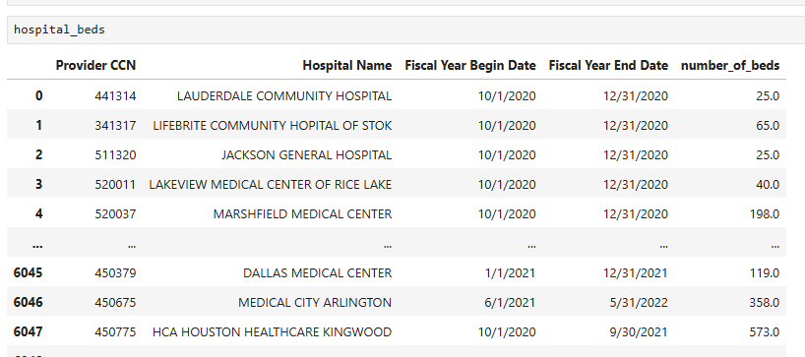
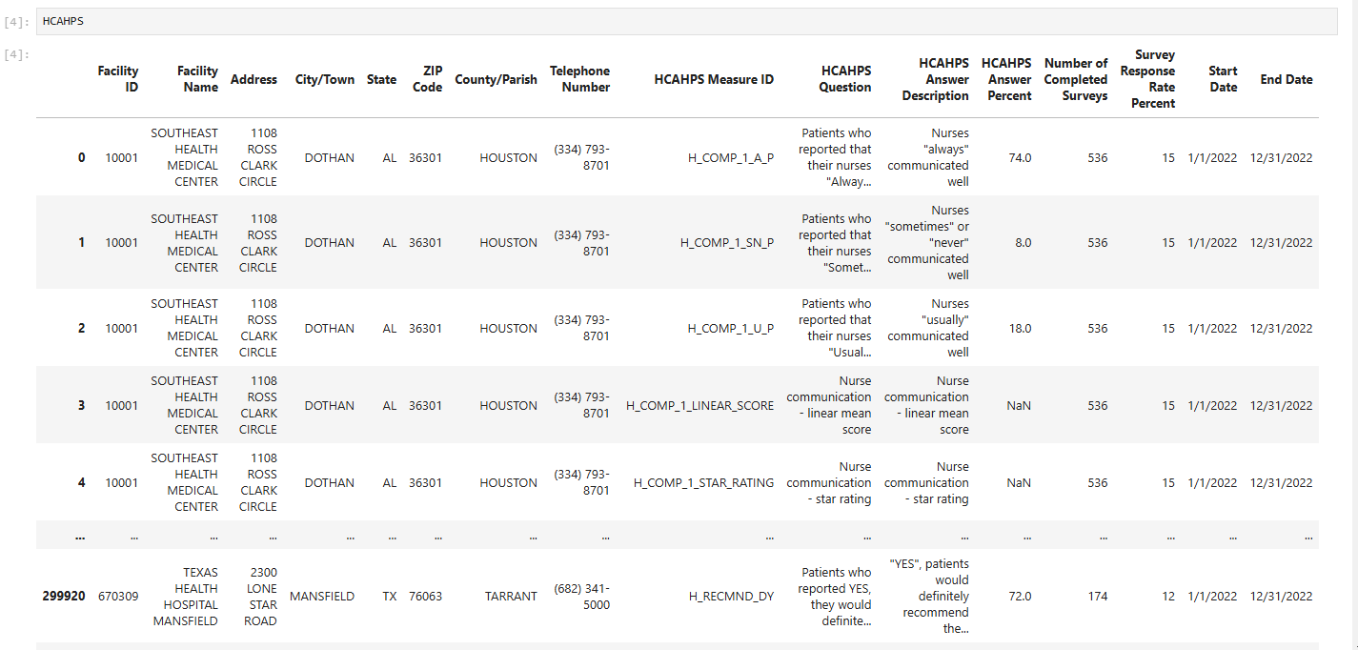
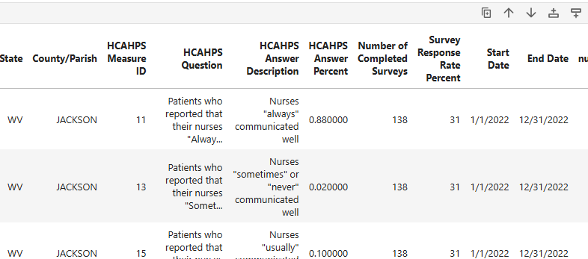
Data Samples
Hospital Beds Data
HCAHPS Data
Merged Data

Slide 13
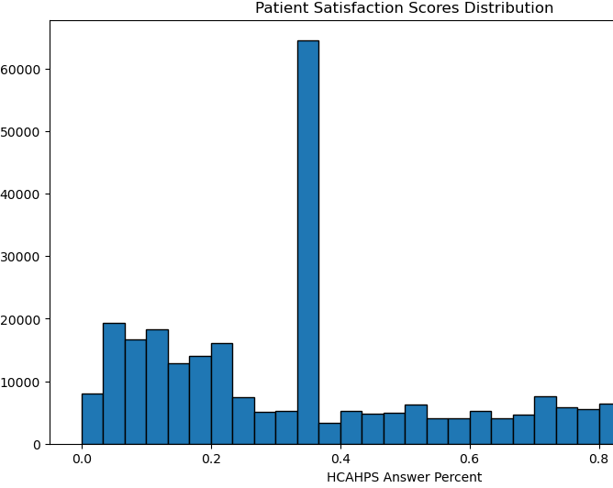
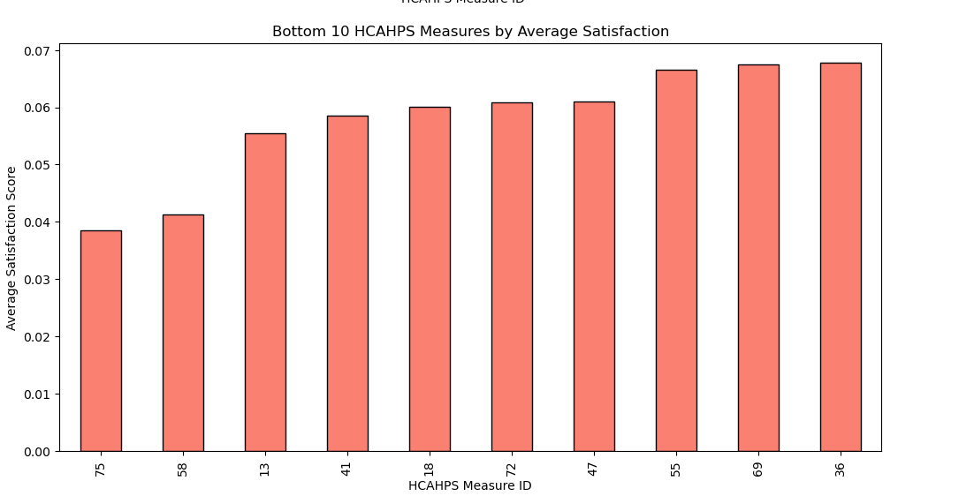
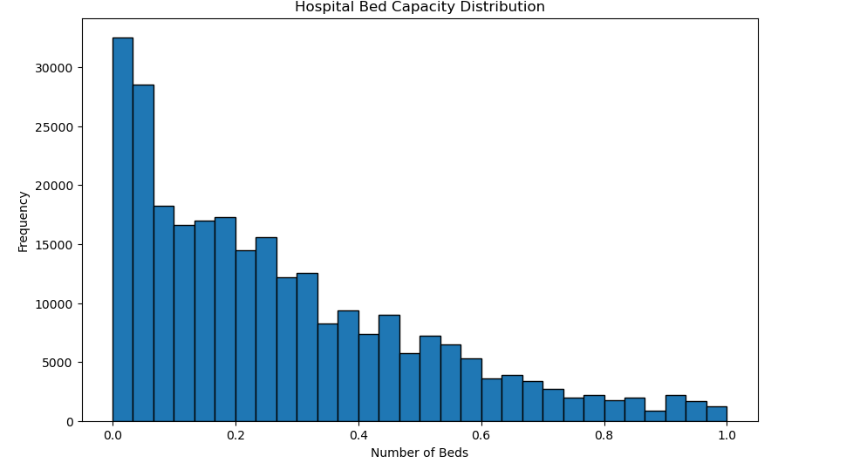
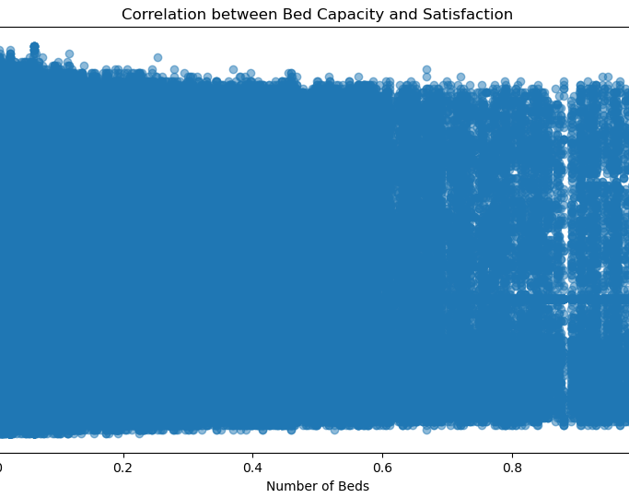
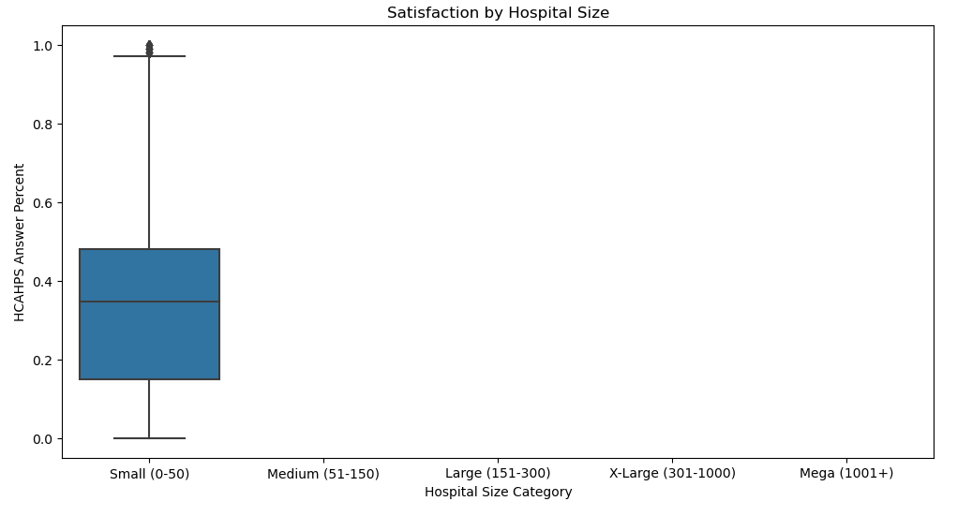
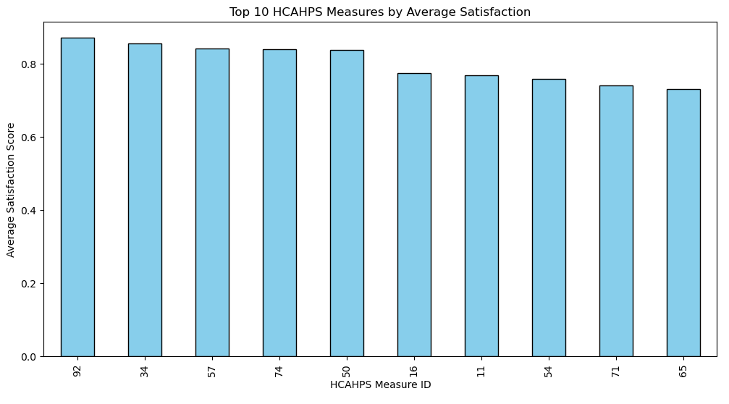
Data Visualization

Slide 14
Model Performance Comparison
Model Performance Comparison: Random Forest - MAE: 0.1895826267099196, R2: -0.012881246198060081
Linear Regression - MAE: 0.18672883815425434, R2: -0.00011557418350482962
Gradient Boosting Regressor - MAE: 0.18705400866521646, R2: -0.0010606349277038074
Best Model based on MAE: Linear Regression with MAE = 0.18672883815425434 and R2 = -0.00011557418350482962

Slide 15

Key Findings
Hospital Size & Satisfaction
Larger hospitals have more consistent satisfaction scores; smaller hospitals show greater variability.
No strong link between bed count and satisfaction, indicating other factors are key.
Important Satisfaction Drivers
Top Factors: Nurse communication and response times are critical to satisfaction.
High scores in communication; lower scores in response times and discharge processes.
Model Performance
Best Model: [e.g., Linear Regression] with the lowest MAE and strong R².
Effective for predicting satisfaction and guiding resource allocation.

Slide 16
Recommendations
Enhance Communication
Invest in communication training for healthcare providers to improve patient interactions.
Optimize Response Times
Implement alert systems for faster response, especially in larger hospitals.
Improve Discharge Support
Provide clear discharge instructions and follow-up support to reduce readmissions.
Utilize Predictive Models
Use models to proactively manage resources and address satisfaction concerns.
Regional Benchmarking
Benchmark against top-performing regional hospitals to adopt best practices.

Slide 17

Areas for Improvement
Expand
Expand Dataset: Add factors like staff-to-patient ratios and specialty services.
Use
Enhanced Feature Engineering: Use interaction terms (e.g., nurse communication × response times).
Test
Advanced Models: Test Gradient Boosting or Neural Networks for better accuracy.
Apply
Hyperparameter Tuning: Apply Grid/Random Search for optimal model settings.
Address
Address Data Imbalance: Use resampling to balance satisfaction scores across hospital types.
Tailor
Demographic & Regional Specificity: Tailor improvements based on trends by demographics and regions.
Use
Improved Visualizations: Use heatmaps and segmented charts for clearer insights.
Track
Temporal Analysis: Track satisfaction over time for proactive resource planning.

Slide 18


